Slide 1
THE TROJAN WAR
Key Facts

Slide 2
The Judgment of Paris
Eris, the Goddess of Discord, was offended at being left out of the marriage banquet of King Peleus and Thetis, the sea nymph
*Fun Fact* Peleus and Thetis are Achilles’ parents
Threw the Golden Apple “For the Fairest” into the banquet.

Slide 3
The Judgment of Paris
Pallas Athena (Goddess of the City, Zeus’ daughter only)
Aphrodite (Goddess of Love and Beauty, Zeus’ daughter)
Hera (Goddess of Marriage, Zeus’ wife)
Ask Zeus to pick – he wisely declines

Slide 4
The Judgment of Paris
Paris: son of Priam and a prince of Troy
Pallas Athena offers Trojan victory against the Greeks
Hera offers to make him Lord of Europe and Asia
Aphrodite offers the fairest woman in all the world

Slide 5
The Trojan War Begins
Helen: daughter of Zeus and Leda, sister of Castor and Pollux, wife of Menelaus
Menelaus: King of Sparta (a city in Greece) and brother of Agamemnon
Paris visits Menelaus and Helen, breaks the sacred bond between a guest and a host, and steals Helen away

Slide 6
The Trojan War Begins
The Greatest Warriors
Greece
Achilles
Troy
Hector: Prince of Troy, son of Priam, Brother of Paris

Slide 7
The Trojan War
The war went on for 9 years!
Agamemnon kidnapped Chryseis
Chryseis was the daughter of Apollo’s oracle at Delphi
Apollo brought down pestilence on the Greeks
Agamemnon realized he had to give Chryseis back, so decided to take Achilles’ woman, Briseis, to replace her
Achilles stops fighting

Slide 8
The Trojan War
Thetis was mad on behalf of her son, Achilles, and asked Zeus to give victory to the Trojans
GREEKS TROJANS Hera Aphrodite Pallas Athena Apollo Artemis Zeus (but afraid to anger Hera)
Zeus sent a lying dream to Agamemnon, convincing him to attack Troy without Achilles

Slide 9
The Trojan War
Paris vs. Menelaus
Menelaus would have defeated Paris if it wasn’t for Aphrodite swooping in and taking Paris back to Troy
Agamemnon declared victory for Greece
Troy would have accepted this if it wasn’t for Hera
Hera convinces Pallas Athena into tricking a Trojan soldier into breaking the cease fire

Slide 10
The Trojan War
With Achilles gone, the two greatest Greek warriors are Ajax and Diomedes
Diomedes almost killed the second greatest Trojan warrior, Aeneas. Aphrodite, Aeneas’ mother, saved him.
Diomedes would have killed Hector, but Ares (God of War) got involved.
Ares’ involvement made Hera mad. She convinced Diomedes to throw a spear at Ares, who fled back to Olympus.
Trojans were in trouble…

Slide 11
The Trojan War
Hector tells him mother to offer Pallas Athena the most beautiful robe in exchange for sparing Troy. Pallas Athena refuses the gift.
Zeus, out of loyalty for Thetis, decided to help the Trojans.
Olympians could not participate in the battle
Zeus alone went to help defeat the Greeks
Close to defeat, Agamemnon realized he had to make amends with Achilles or the Greeks would lose

Slide 12
The Trojan War
Odysseus and two chieftains went to meet with Achilles.
Offered him riches
Appealed to his pity
Achilles refused to help the Greeks.
Hera was very angry at Zeus for helping Troy. She made herself irresistible and tempted him away from his promise to Thetis. Zeus stopped helping the Trojans.

Slide 13
The Trojan War
Greeks took the upper hand!
Ajax wounded Hector and would have destroyed Troy if Zeus had not suddenly realize what Hera did.
Hera blamed Poseidon!
Zeus did not believe her, but sent Iris to tell Poseidon to stop helping the Greeks.
Apollo revived Hector

Slide 14
The Trojan War
Patroclus, Achilles’ best friend
Unable to stand by and watch the Greeks suffering without their greatest warrior, Patroclus takes Achilles’ armor and heads off to battle.
Hector kills Patroclus and takes his armor

Slide 15
The Trojan War
Achilles, wearing new magical armor, returns to the Greeks to make amends
Achilles, with the help of Pallas Athena, faces Hector. He chases him 3 times around the gates of Troy
Achilles kills Hector and instead of returning his body to Priam, he drags the body around the city
This behavior angered the gods, who gave Priam safe passage to meet with Achilles
Priam moves Achilles’ heart and retrieves Hector’s body

Slide 16
The Fall of Troy
As fated, Achilles died soon after Hector
Paris shoots an arrow (with the help of Apollo) that hits Achilles in his heel
Achilles’ armor was given to Odysseus

Slide 17
The Fall of Troy
Odysseus kidnaps the prophet Helenus and learns that Troy will not fall until someone fights with Hercules’ bow and arrows.
***PROBLEM: Hercules’ armor is with Prince Phioctetes, a man the Greeks left for dead during the war***
Odysseus successfully steals Hercules’ bow and arrow form Philoctetes AND brings Philoctetes back with them
Philoctetes wounds Paris with arrow. Paris dies.

Slide 18
The Fall of Troy
As long as Troy has the sacred image of Pallas Athena (the Palladium), the city will not fall
Odysseus developed a plan!
Build a hollow wooden horse
Persuade the Trojans to bring the horse inside the city
Leave a single Greek behind in their deserted camp to ensure the horse is safely accepted (Sinon)

Slide 19
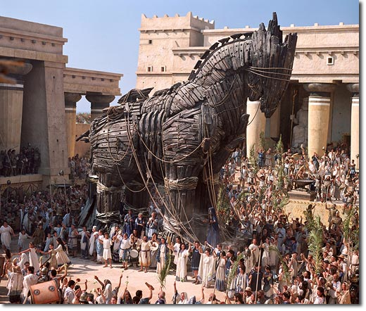

Slide 20
The Fall of Troy
Troy was destroyed
Trojans were slaughtered
Priam was killed by Achilles’ son
Aeneas was the only leader to survive
Helen (with the help of Aphrodite) escaped back to Menelaus

